Slide 1
Namma kadai
Introduction:
Mention that the project aims to develop a management system for a company named "Namma Kadai.“
Explain the challenges faced by Namma Kadai in managing its cash balance and inventory.
Emphasize the need for a comprehensive solution to streamline item management, purchases, and sales.

Slide 2
1. Adding New Items: Adding new items to the inventory is a straightforward process designed to expand the product offerings of Namma Kadai. To add a new item, users can access the "Add/Edit/View Item" view. In this view, they can provide details such as the item name and any other relevant information. Upon submission, the system stores the item details in the "Item" table, creating a new entry for the item. This process ensures that the inventory is up-to-date with the latest products available for purchase and sale. Namma Kadai can now easily manage its product range through this intuitive and user-friendly interface.

Slide 3
2. Recording Purchases: One of the key aspects of the management system is the ability to record purchases accurately and efficiently. Users can access the "Add/View Purchase" view to record new purchases made by Namma Kadai. To record a purchase, users need to specify the purchased item, the quantity, and the rate at which the purchase was made. The system calculates the total amount of the purchase (quantity * rate) and updates the cash balance of Namma Kadai by subtracting the purchase amount. The purchase details, including the item, quantity, rate, and amount, are then recorded in the "Purchase" table for future reference. This streamlined process ensures accurate tracking of inventory and cash flow, contributing to better financial management.

Slide 4
3. Recording Sales: The system also facilitates the recording of sales transactions to track revenue and manage inventory levels. Users can navigate to the "Add/View Sales" view to record sales made by Namma Kadai. When recording a sale, users need to select the sold item, specify the quantity sold, and provide the rate at which the item was sold. Similar to the purchase process, the system calculates the total sale amount (quantity * rate) and updates the cash balance by adding the sale amount. The sales details, including the item, quantity, rate, and amount, are stored in the "Sales" table for future reference. This process allows Namma Kadai to monitor sales performance and maintain accurate records of revenue generated.

Slide 5
4. Real-time Cash Balance:
A significant advantage of the management system is the real-time cash balance tracking feature.
Every purchase and sale transaction directly impacts the cash balance of Namma Kadai.
As purchases are recorded, the cash balance decreases by the purchase amount.
Conversely, as sales are recorded, the cash balance increases by the sale amount.
This real-time update ensures that Namma Kadai always has an accurate understanding of its financial position.
The system provides a clear and immediate overview of available funds for further purchases, expenses, and investments.

Slide 6
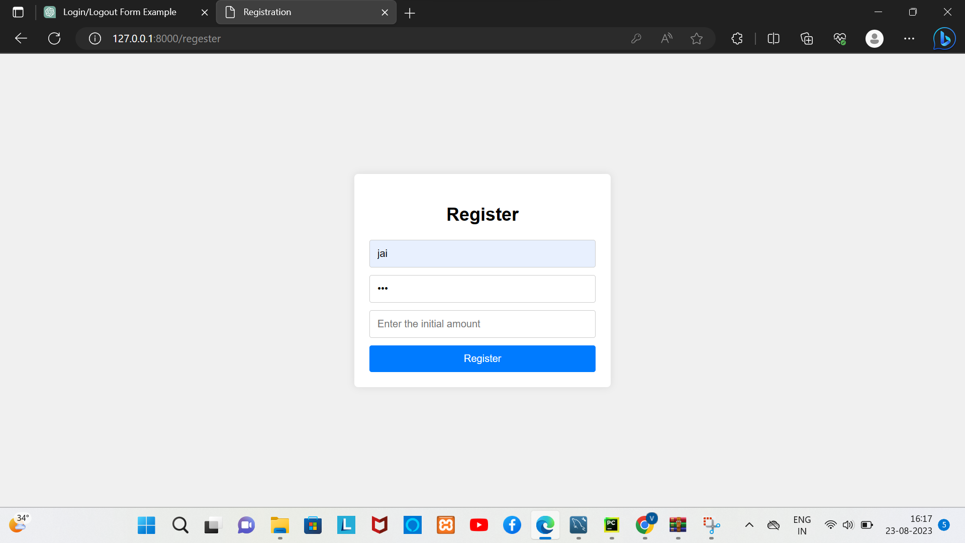

Slide 7
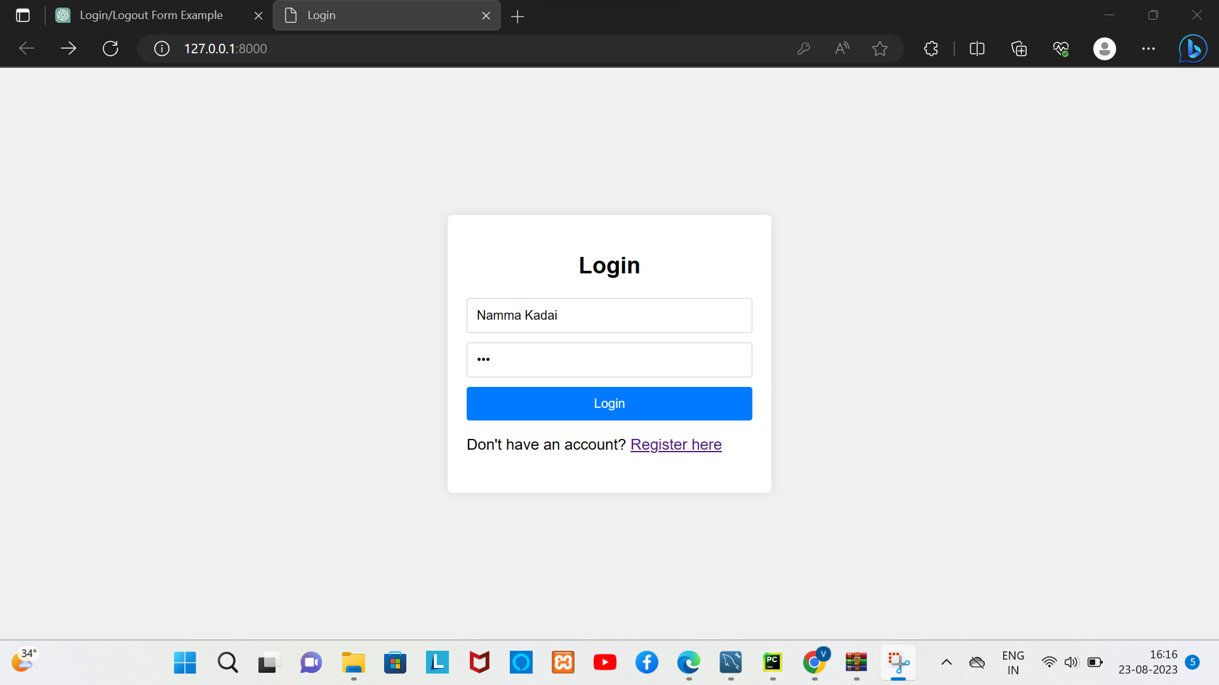

Slide 8
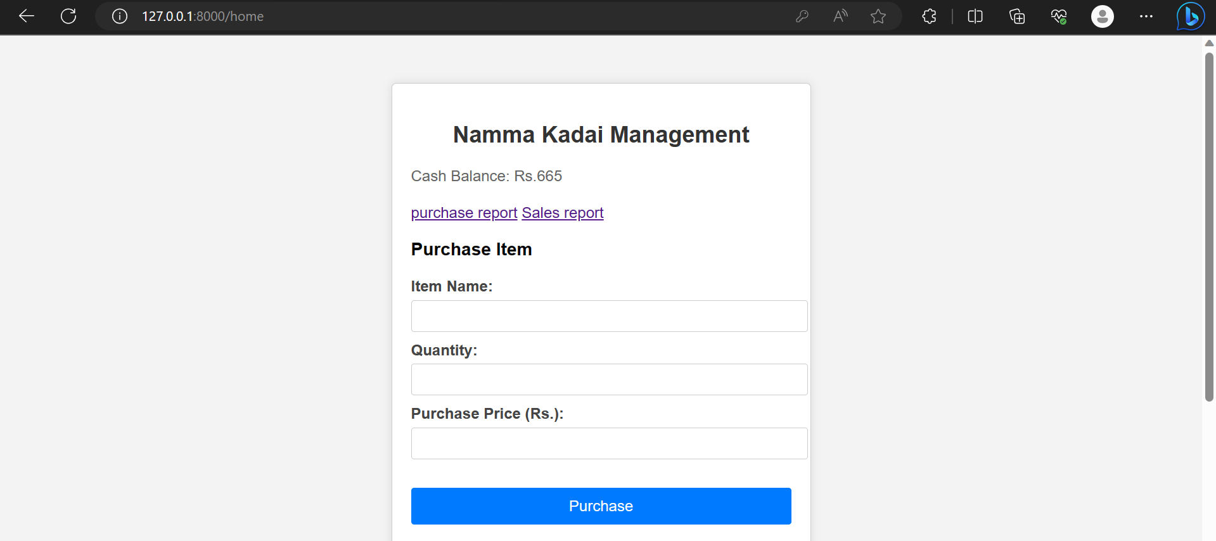

Slide 9
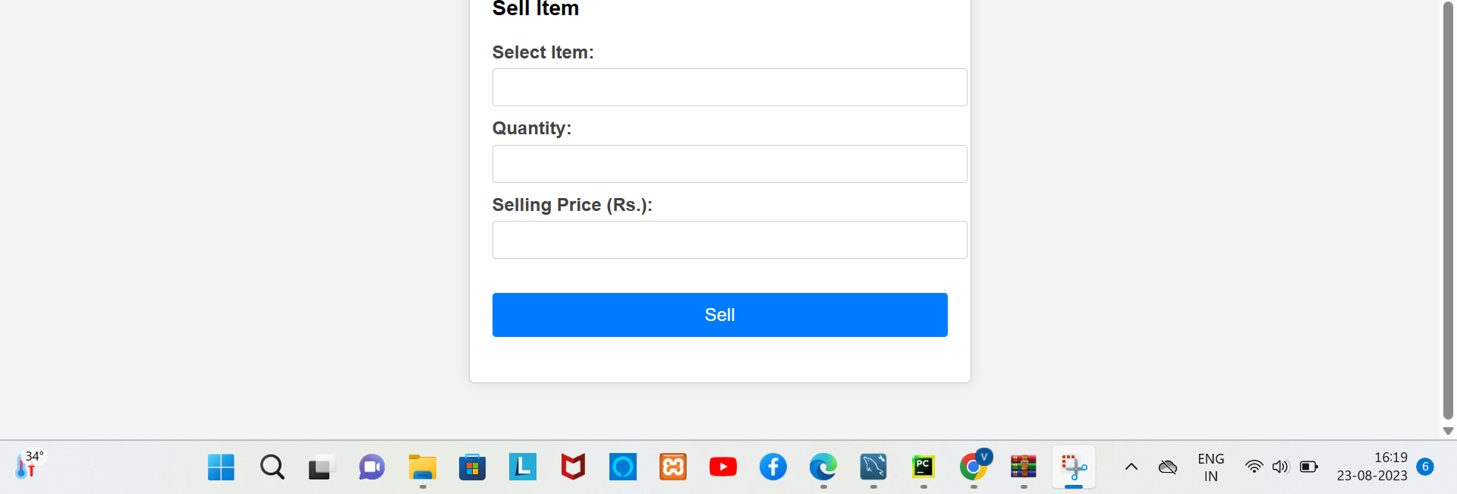

Slide 10
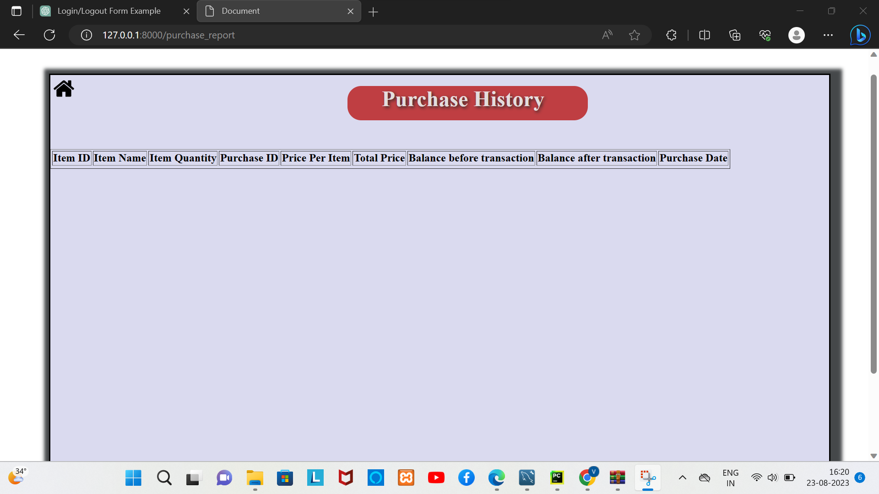

Slide 11
